Slide 1
Refactoring
Presentation by:
Slaven Mlinaric

Slide 2

IU Informatik dual student Slaven Mlinaric
Programming skills: C++, JavaScript/TypeScript, HTML, CSS,
Hobbies: dancing, guitar, basketball
Pets: 2 Hunde
…

Slide 3

Here are some of the questions I will try to answer in my presentation:
What is refactoring?
Why is it important?
Are there any advantages to refactoring or is it a waste of time?
Are there any negative sides?

Slide 4
Before we start here’s
WHY?

Slide 5

Refactoring Improving the Design of Existing Code -Martin Fowler

Slide 6
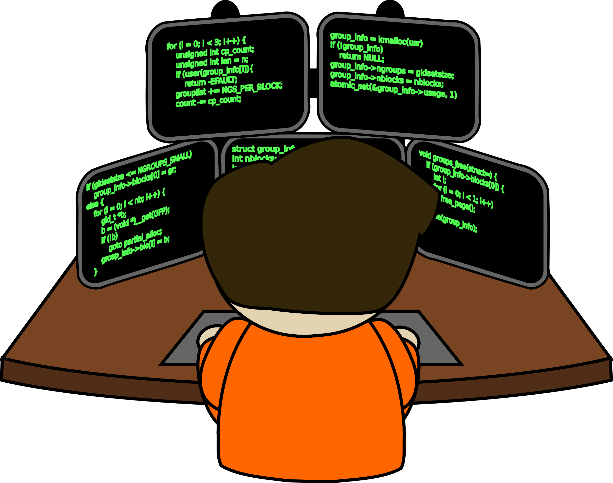
?
?
?
?
?
?
?
?

Slide 7
What is refactoring?
Definition by Martin Fowler:
noun: a change made to the internal structure of software to make it easier to understand and cheaper to modify without changing its observable behavior.
verb: to restructure software by applying a series of refactorings without changing its observable behavior.

Slide 8
Catalog of refactorings by Martin Fowler:
Change Function Declaration
Change Reference to Value
Change Value to Reference
Collapse Hierarchy
Combine Functions into Class
Combine Functions into Transform
Consolidate Conditional Expression
Decompose Conditional
Encapsulate Collection
Encapsulate Record
Encapsulate Variable
Extract Class
Extract Function
Extract Superclass
Extract Variable
Hide Delegate
Inline Class
Inline Function
Inline Variable
Introduce Assertion
Introduce Parameter Object
Introduce Special Case
Move Statements to Callers
Parameterize Function
Preserve Whole Object
Pull Up Constructor Body
Pull Up Field
Pull Up Method
Push Down Field
Push Down Method
Remove Dead Code
Remove Flag Argument
Remove Middle Man
Remove Setting Method
Remove Subclass
Rename Field
Rename Variable
Replace Command with Function
Replace Conditional with Polymorphism
Replace Constructor with Factory Function
Replace Control Flag with Break
Replace Derived Variable with Query
Replace Error Code with Exception
Replace Exception with Precheck
Replace Magic Literal
Replace Nested Conditional with Guard Clauses
Replace Parameter with Query
Replace Primitive with Object
Replace Query with Parameter
Replace Subclass with Delegate
Replace Superclass with Delegate
Replace Temp with Query
Replace Type Code with Subclasses
Return Modified Value
Separate Query from Modifier
Slide Statements
Split Loop
Split Phase
Split Variable
Substitute Algorithm
Replace Loop with Pipeline
Move Statements into Function
Replace Inline Code with Function Call
Move Function
Replace Function with Command
Move Field

Slide 9
Example:
Imagine a company of theatrical players who go out to various events performing plays. Typically, a customer will request a few plays and the company charges them based on the size of the audience and the kind of play they perform. There are currently two kinds of plays that the company performs: tragedies and comedies. As well as providing a bill for the performance, the company gives its customers “volume credits” which they can use for discounts on future performances—think of it as a customer loyalty mechanism.

Slide 10
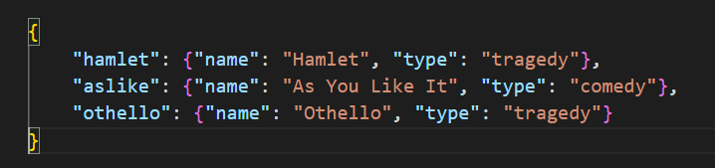
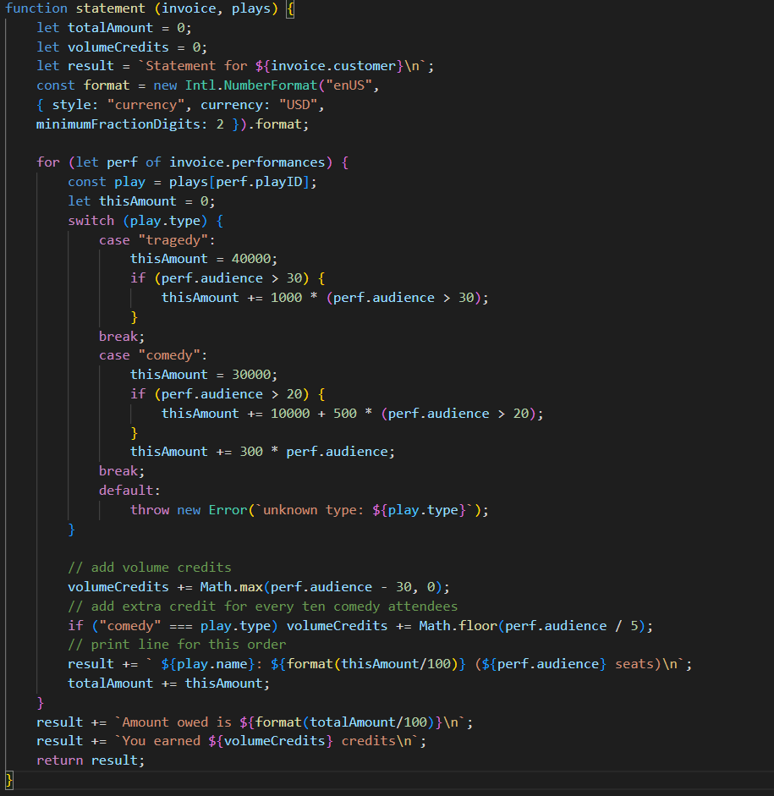
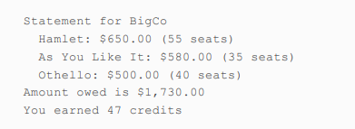
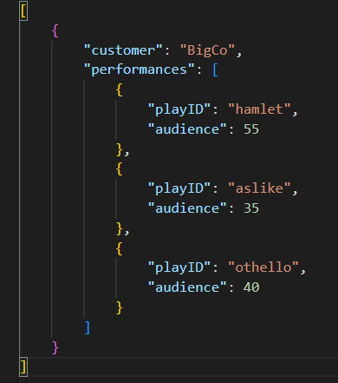
plays.json
print.js
Output:
Invoices.json

Slide 11
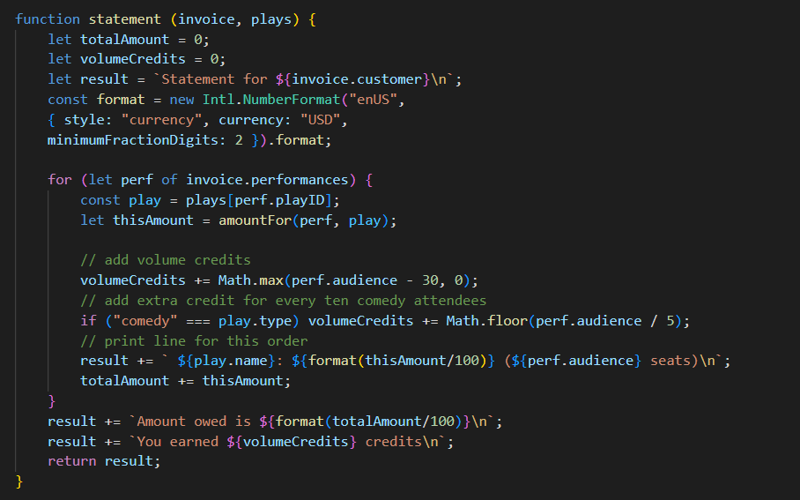
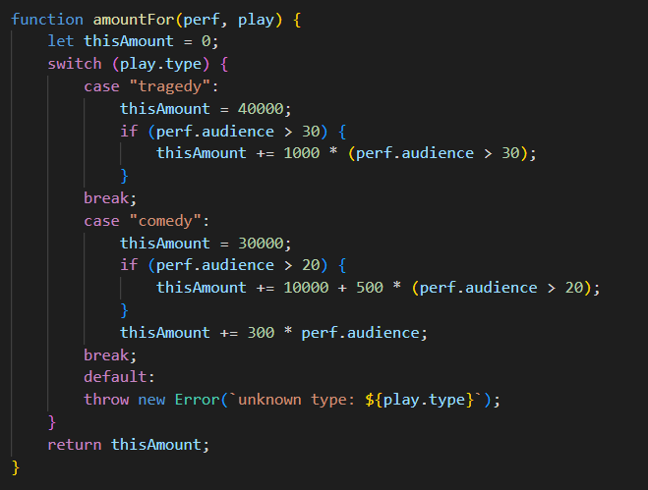
Extract Function:

Slide 12
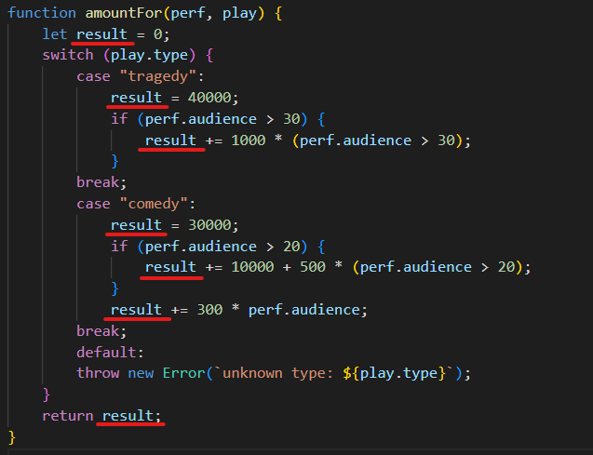
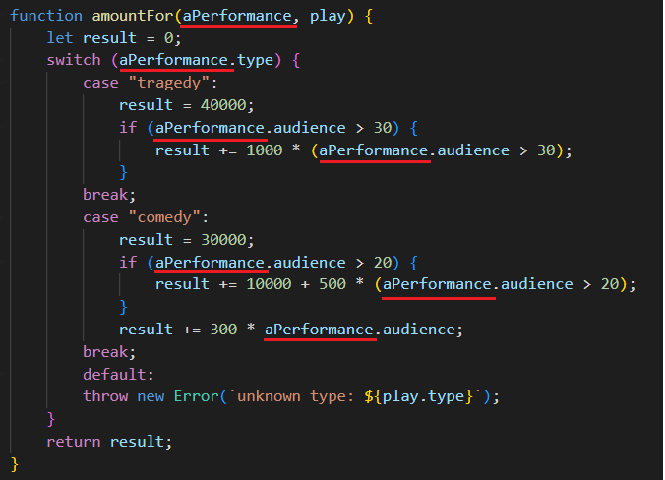
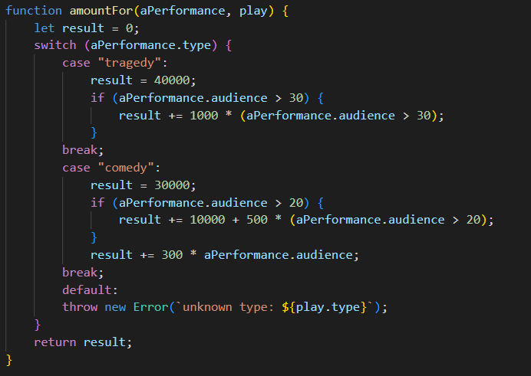


Slide 13


Slide 14


Two hats:
Adding funtionality
Refactoring

Slide 15
Refactoring
Adding funtionality

Slide 16


Slide 17



Slide 18
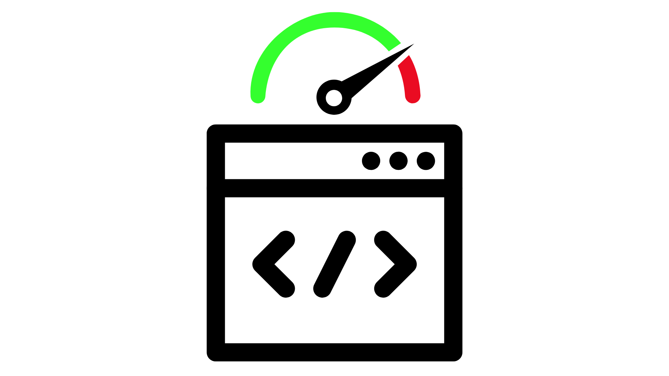

Slide 19
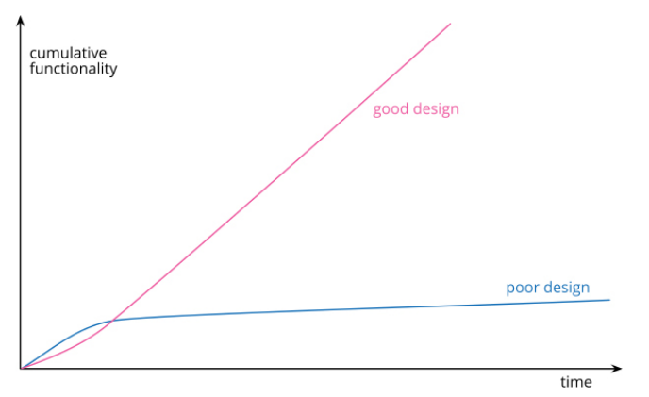
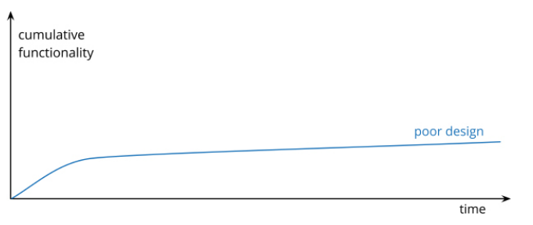

Slide 20
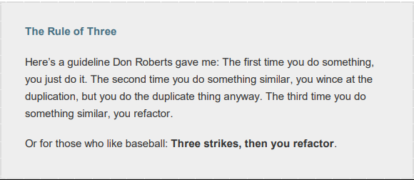
When should we refactor?

Slide 21
Refactoring fits into workflow in more than one way
Preparatory Refactoring—Making It Easier to Add a Feature
Comprehension Refactoring: Making Code Easier to Understand
Litter-Pickup Refactoring
Planned and Opportunistic Refactoring
Long-Term Refactoring

Slide 22

What Do I Tell My Manager?

